Slide 1
MASTPAWG 2023
Critical soil test values of P and K for North Carolina
Luke Gatiboni
Deanna Osmond
David Hardy
Luke_Gatiboni@ncsu.edu

Slide 2
SOIL TEST CORRELATION AND CALIBRATION STUDIES
NC has a long historic of Soil Test Correlation/Calibration Studies
Yield
Yield
Fertilizer increases yield
No response to fertilizers
CRITICAL SOIL TEST VALUE
1939 – NC Soil Testing Lab
25
50
75
100
1940s- Statewide field trials
Soil test P or K

Slide 3
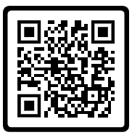
Soil test calibration data that support the current recommendations
It is not easy to track the research results that were used to build the fertilizer recommendations
https://www.ncagr.gov/agronomi/pdffiles/obook.pdf

Slide 4
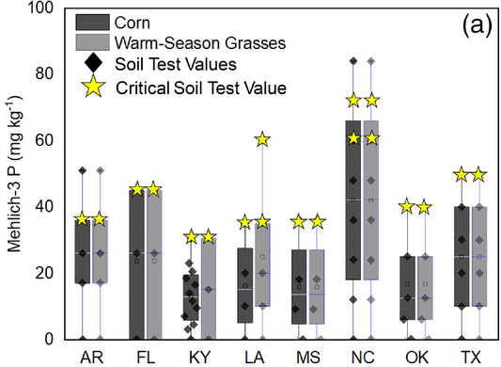
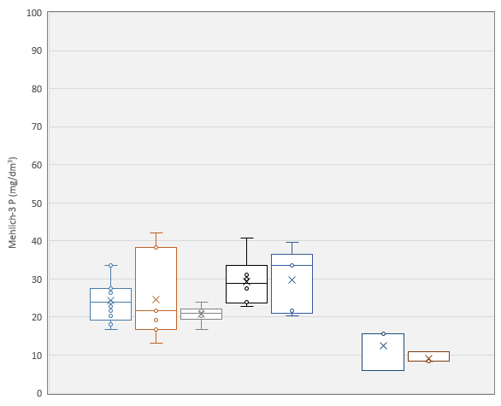
Critical Soil Test Values for NC soils and Crops
Shelton et al. (1961)
Cox & Lins (1984)
Cox (1992)
Cox (1996)
Kamprath (1999)
Cox & Barnes (2002)
Crozier et al. (2004)
Range of CSTVs in the Southern U.S.
Current CSTV
Zang et al. (2021)
Corn
n=15
Cotton
n=7
Peanut
n=6
Soy
n=6
Wheat
n=5
Wheat
n=3
Corn
n=3
Coastal Plain/Tidewater
Piedmont

Slide 5
Observed yield response
in piedmont soils
Observed yield response
in coastal plain soils
Historically predicted
yield response in NC soils
100
Percent of maximum yield
50
Observed
CSTV
(piedmont)
Observed
CSTV
(coastal plain)
Historically established
CSTV
0
0
15
30
60
120
Soil P

Slide 6
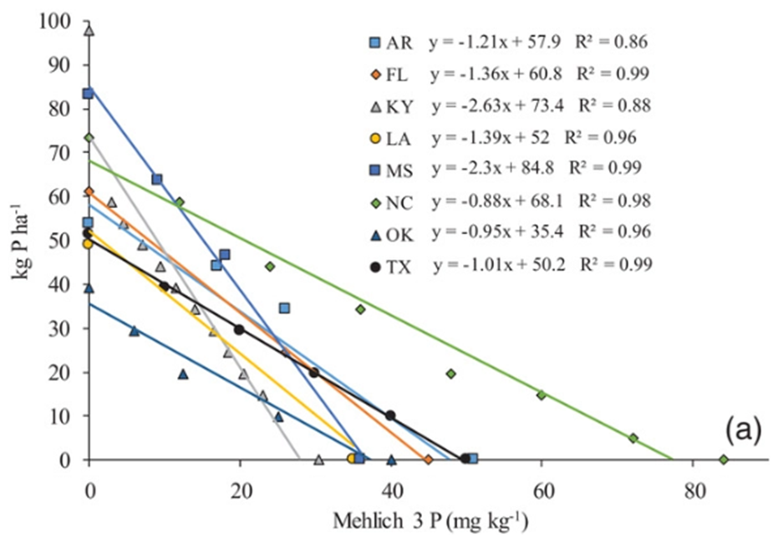
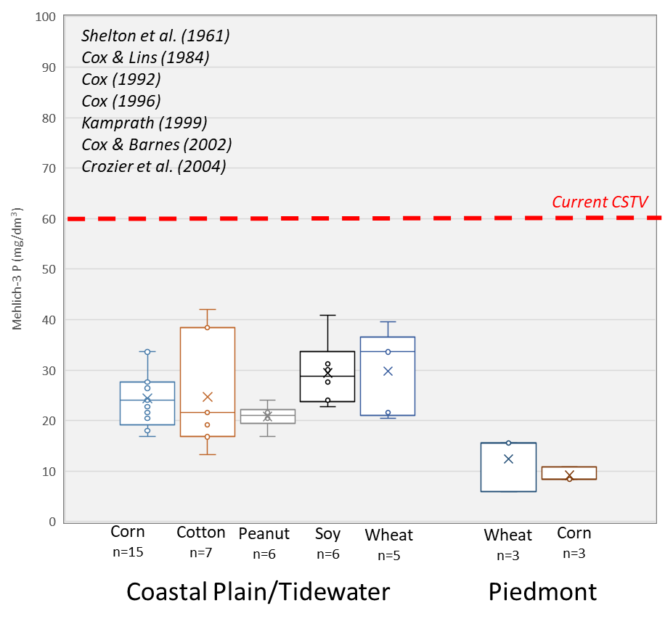
Critical Soil Test Values for NC soils and Crops
Fertilizer P rate recommendations for corn at a yield goal of 10.1 Mg/ha
Zang et al. (2021)

Slide 7
Consequence: Build-up of Phosphorus in NC soils
Percentage of soil samples in each P availability class (Samples analyzed by NCDA&CS FY 2019 + 2020 – 431,884 soil samples)
 | Mehlich-3 P (mg/dm³)
 | < 30 | 31 - 60 | 61 - 120 | > 120
Cotton | 1 | 11 | 39 | 49
Grains | 2 | 11 | 34 | 53
Pasture/hay | 14 | 13 | 19 | 54
Peanut | 0 | 4 | 26 | 69
(D. Hardy, personal communication, Jan. 2021)

Slide 8
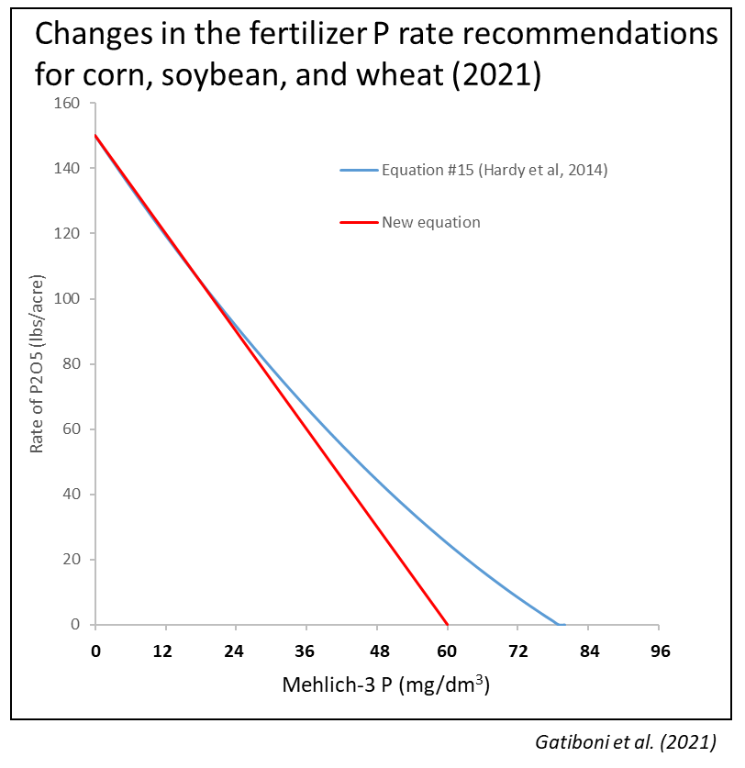
- We created the Interagency Soil Test Phosphorus Committee
L. Gatiboni
D. Hardy
D. Osmond
S. Kulesza
D. Crouse
J. Havlin
C. Hudak-Wise
Revise the equation for recommending P to have zero P fertilization in soils with P > 60 mg/dm³
Start a set of field trials to check if the P CSTVs are up to date

Slide 9
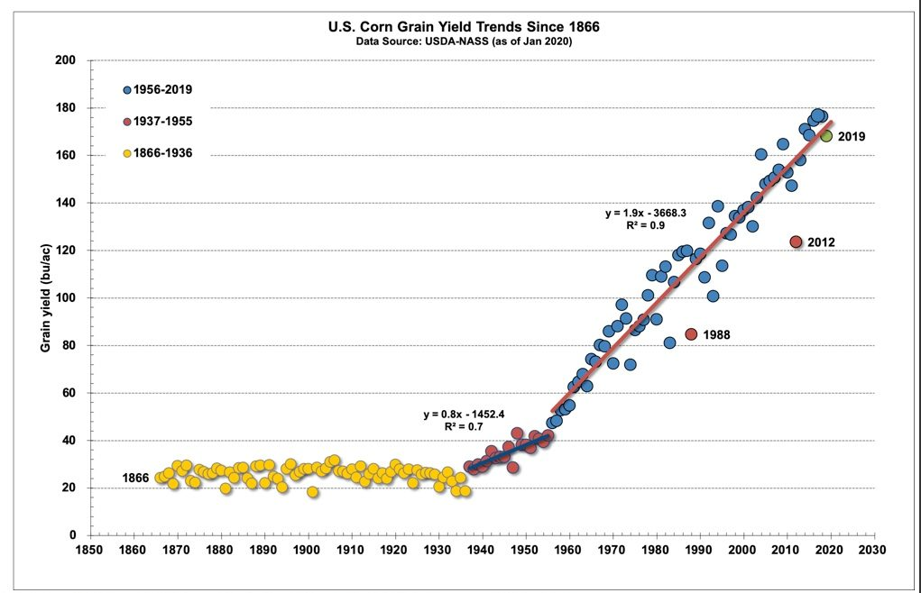
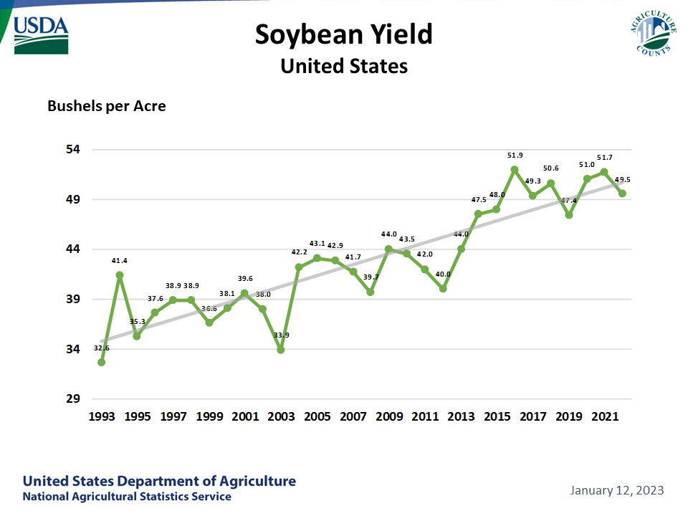
Nielsen (2020)
Why CSTV studies are still important for NC?
Motivation:
No recent data about CSTVs in NC
Changes in crop varieties and yield potential since the 80s/90s
NC Commodity Groups were interested in fertilization for High-Yield environments

Slide 10

Two set of trials were used
90
81.5
60
Soybean Yield (bu/acre)
1 – Long-term trials located in research stations
2 – On-farm trials in high-yielding soybean environments
37
30
Additional greenhouse experiment:
0
NC
Average
Average
2020 Yield Contest (non-irrigated)
3 – Early season corn P CSTV

Slide 11
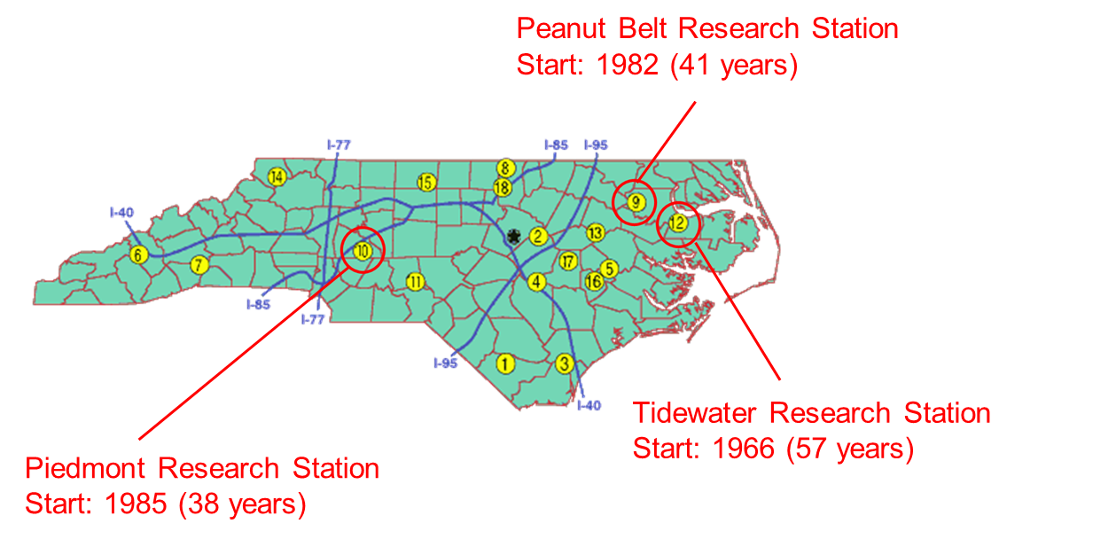
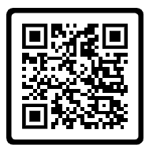
1 - P & K LONG-TERM TRIALS
Objective: Track the P and K CSTVs over the years
Nelida Morales
https://doi.org/10.1002/saj2.20491

Slide 12
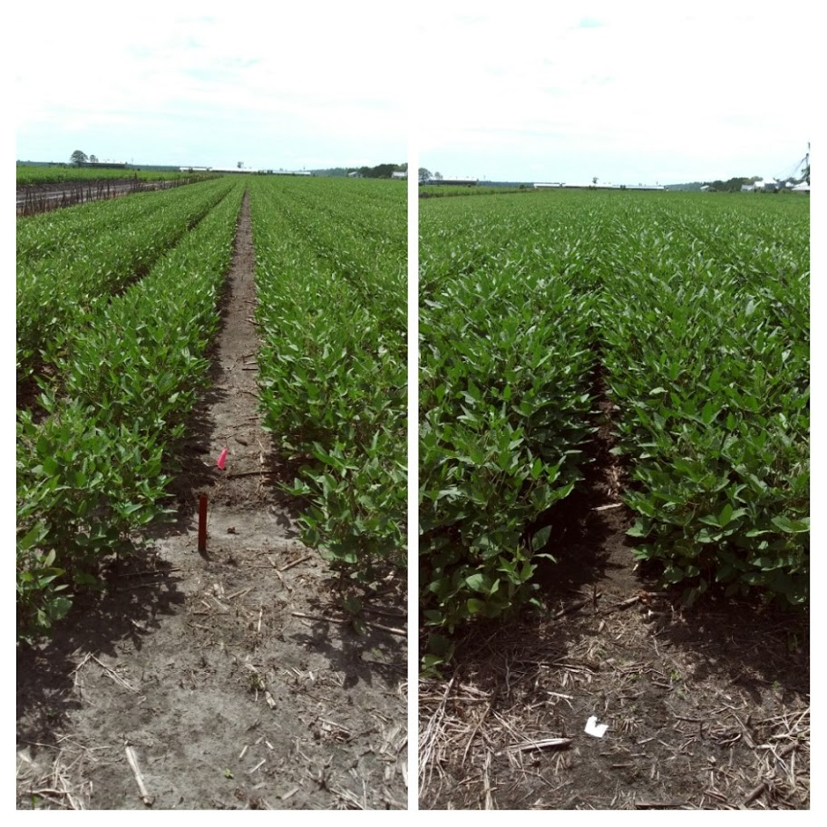
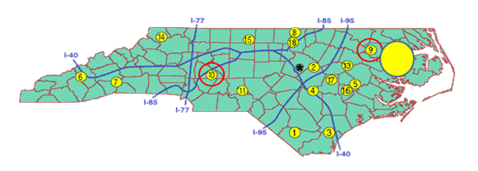
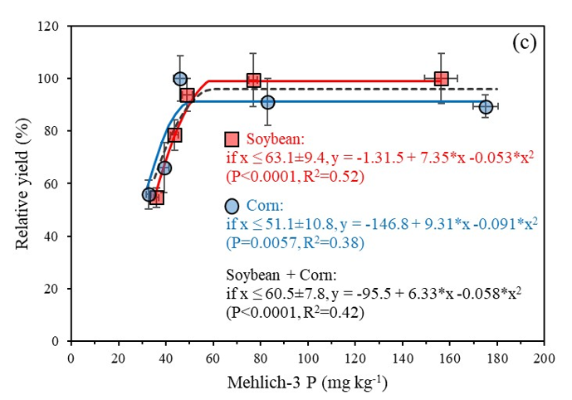
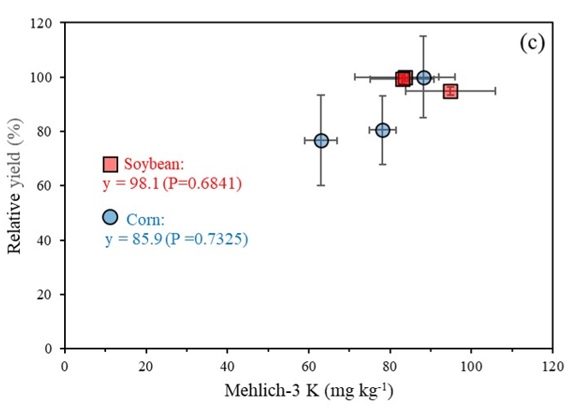
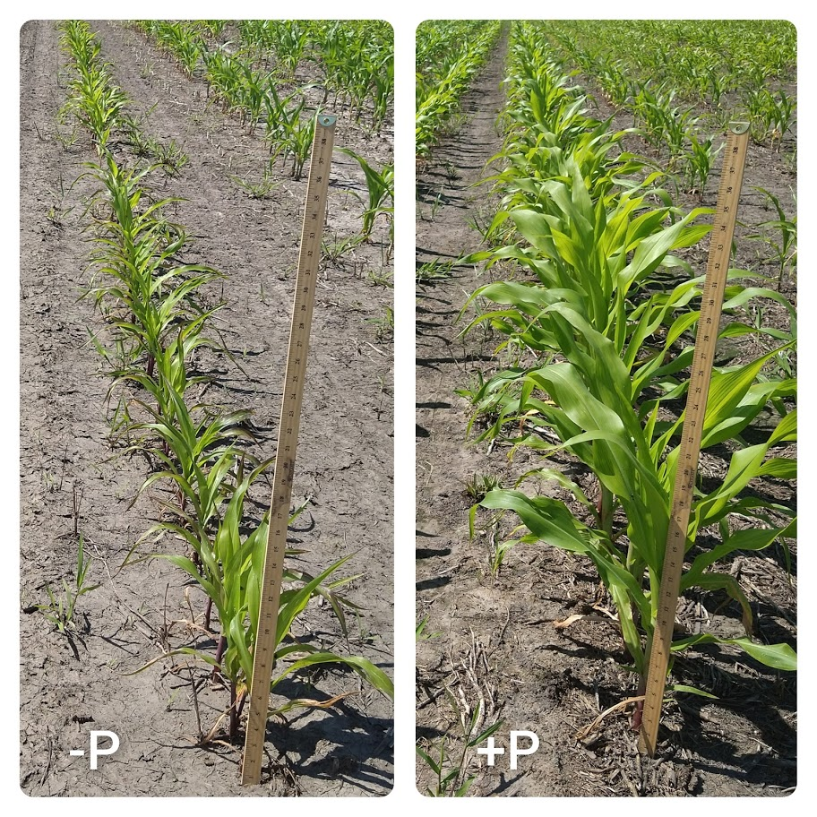
Tidewater Research Station (since 1966)
Rates of P: 0 to 160 kg P2O5/ha
Rates of K: 0 to 35 kg K2O/ha
LP(JP) – 64 and 57 mg/dm³
QP(95) – 60 and 51 mg/dm³

Slide 13
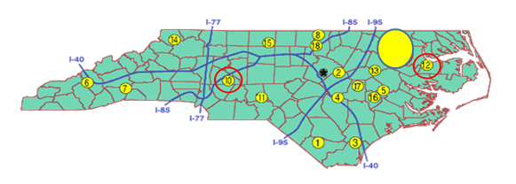
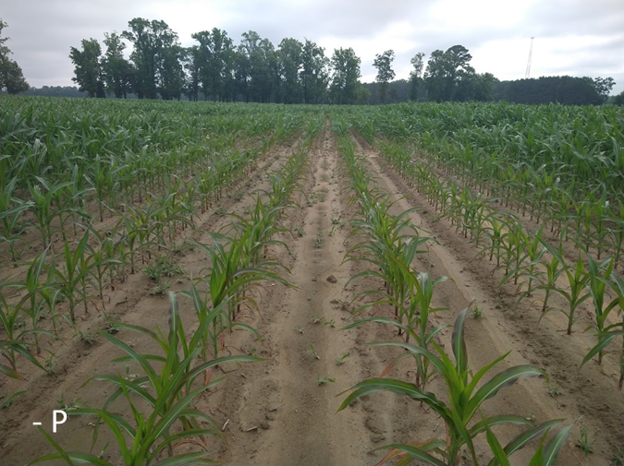
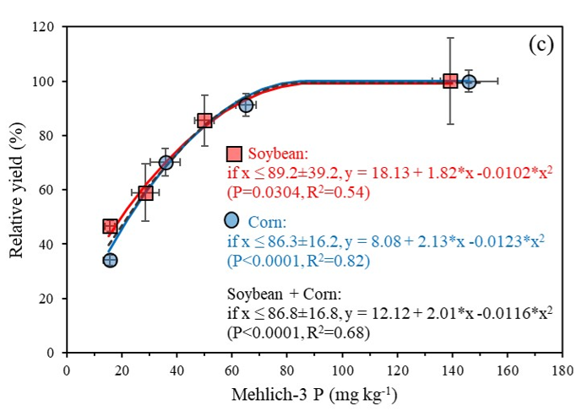
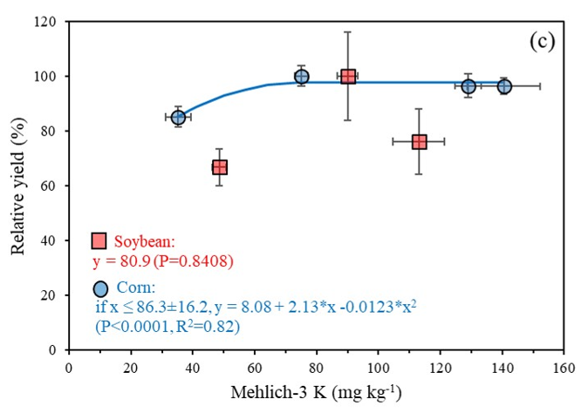
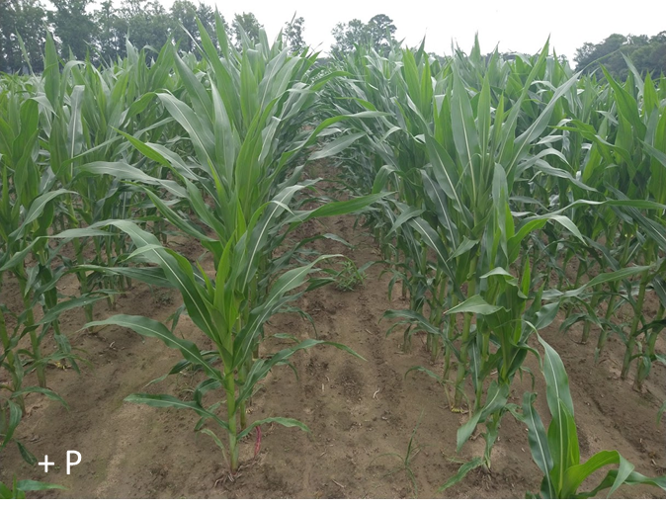
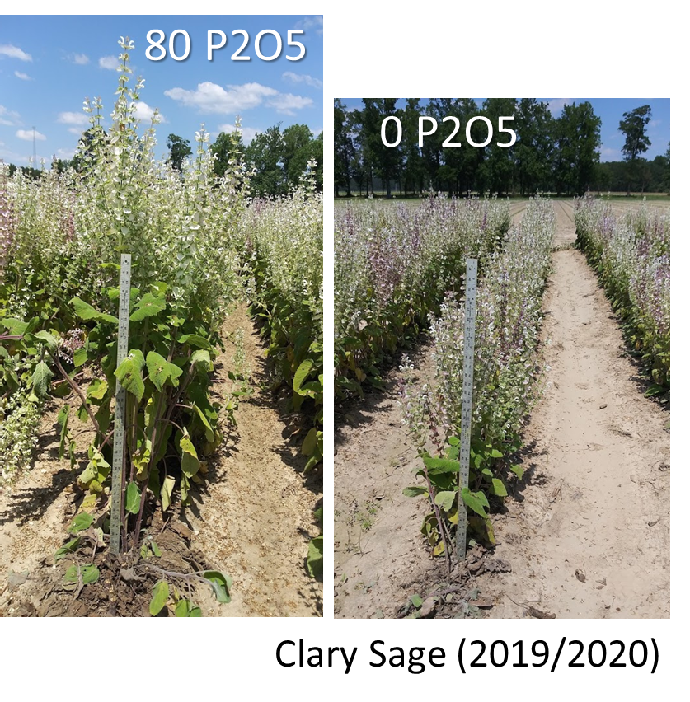
Peanut Belt Research Station (since 1982)
Rates of P: 0 to 100 kg P2O5/ha
Rates of K: 0 to 120 kg K2O/ha
LP(JP) – 56 and 67 mg/dm³
QP(95) – 77 and 76 mg/dm³
LP(JP) – 66 mg/dm³
QP(95) – 57 mg/dm³

Slide 14
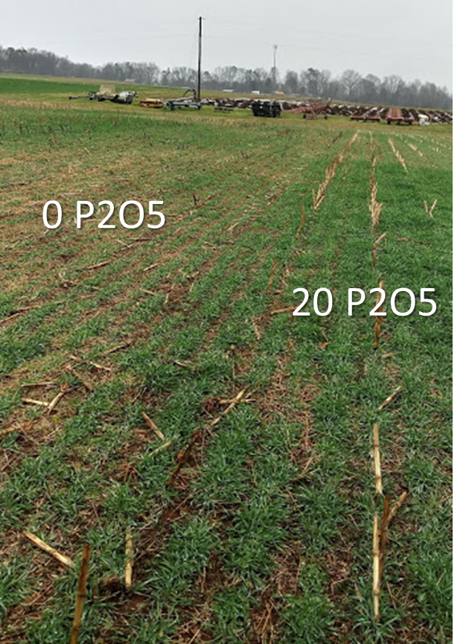
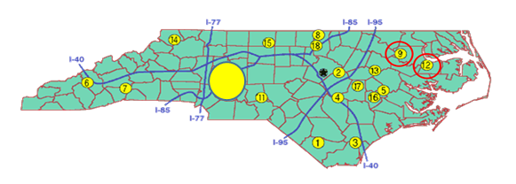
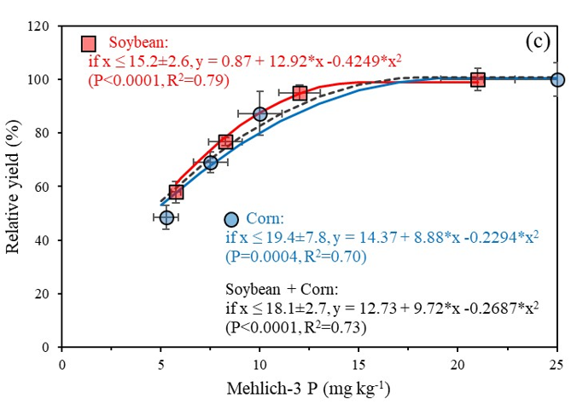
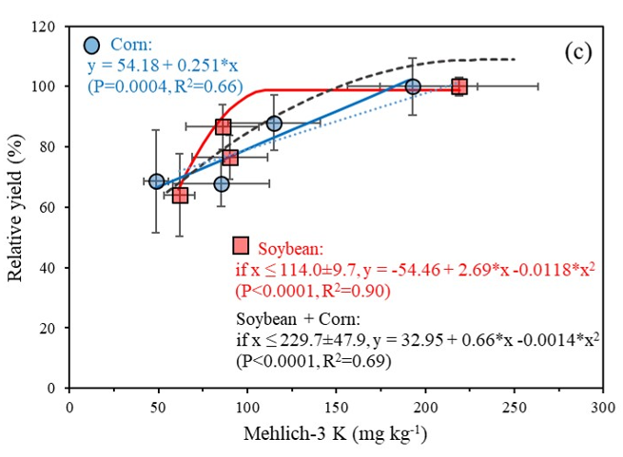
Piedmont Research Station (since 1985)
Rates of P: 0 to 45 kg P2O5/ha
Rates of K: 0 to 115 kg K2O/ha
LP(JP) – 14 and 14 mg/dm³
QP(95) – 14 and 17 mg/dm³
LP(JP) – 96 mg/dm³
QP(95) – 107 mg/dm³

Slide 15

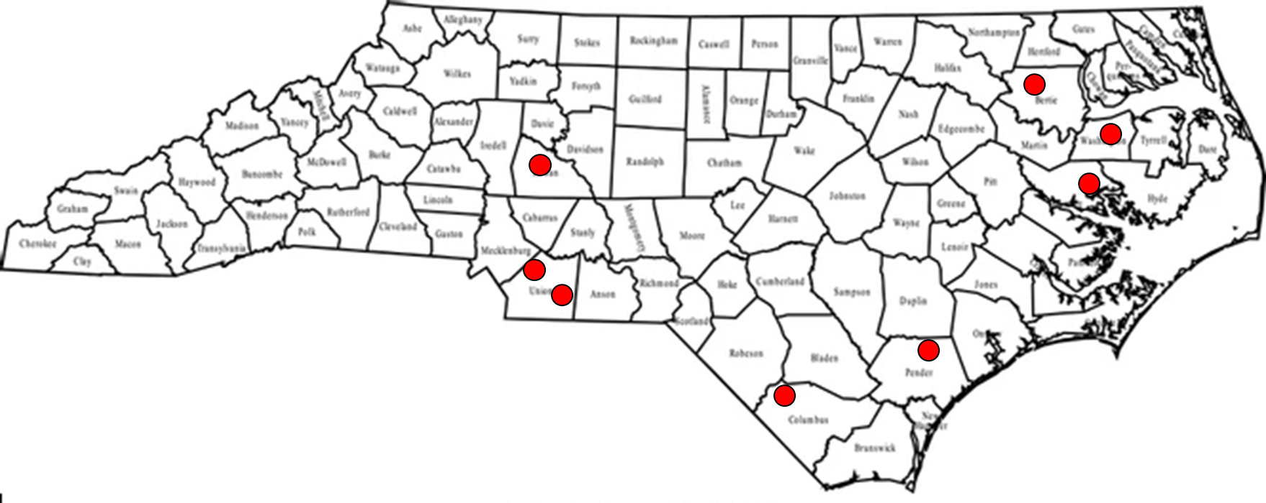
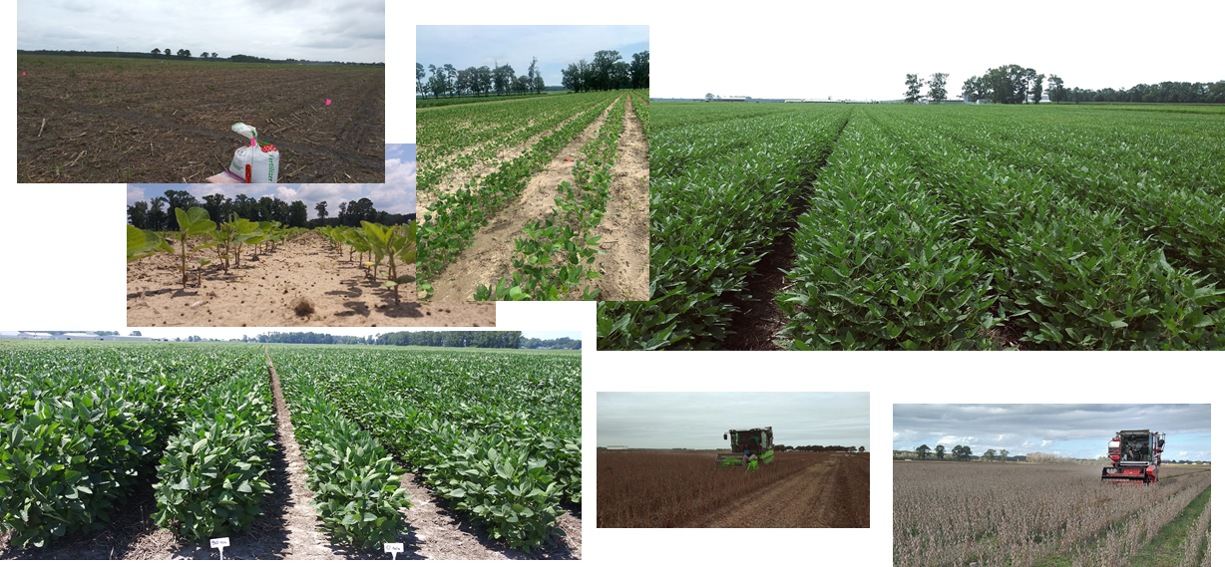
2 - On-farm P and K correlation calibration For high-yielding soybeans
Objective: check if the CSTVs are adequate for fields yielding > 60 bu/acre
Lydia Miles
2020 – 2 sites
2021 – 4 sites
2022 – 2 sites

Slide 16
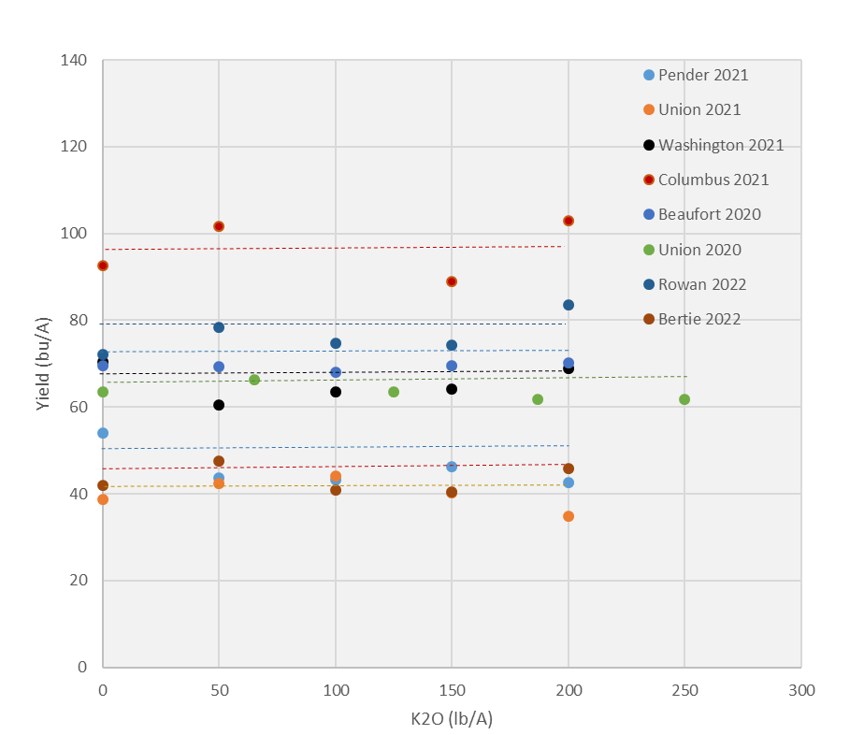
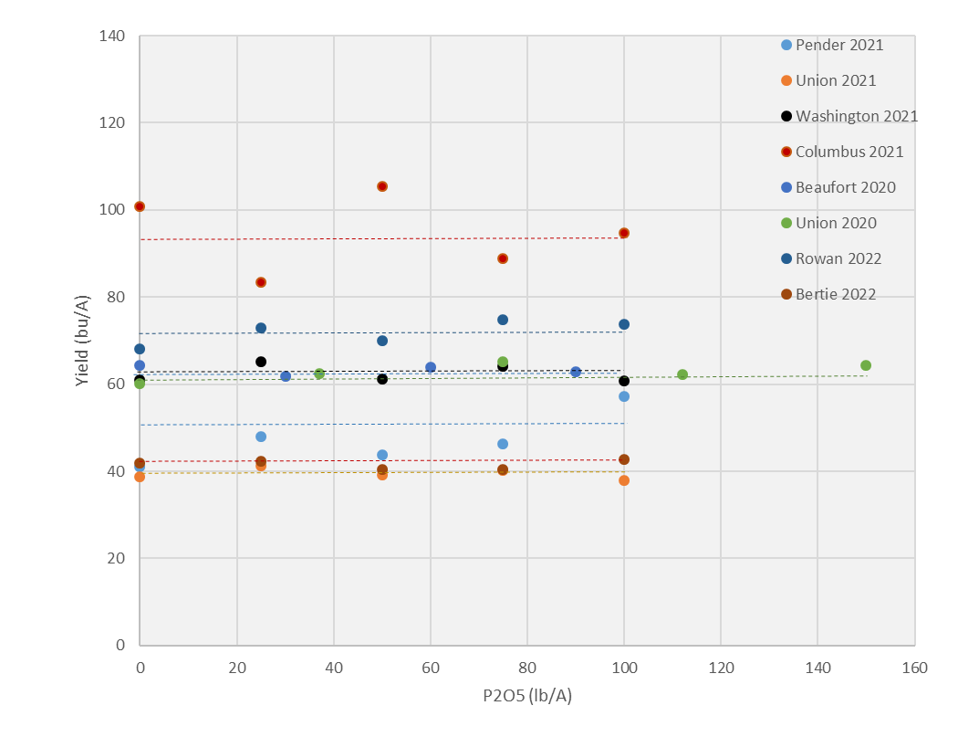
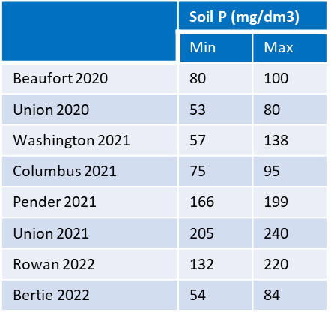
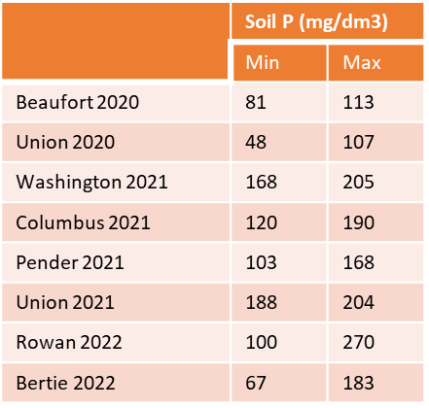
2 - On-farm P and K correlation calibration For high-yielding soybeans
Soil K (mg/dm³)

Slide 17
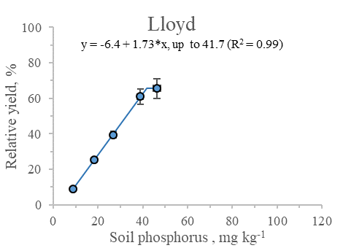
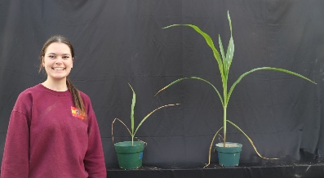
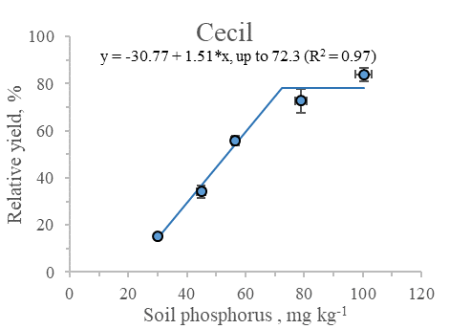
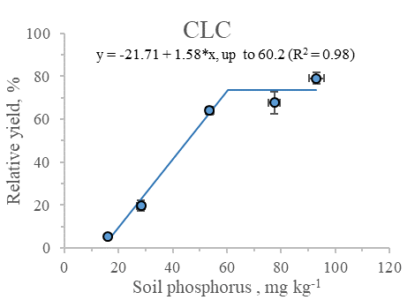
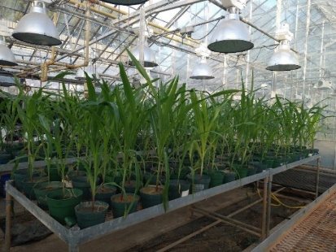
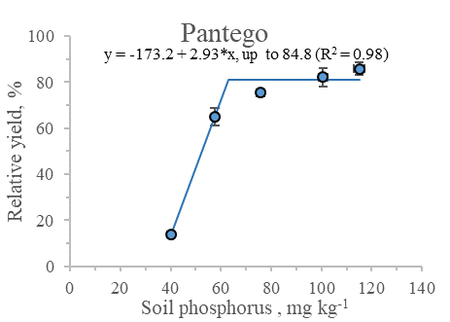
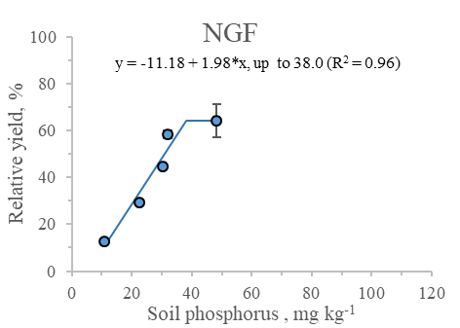
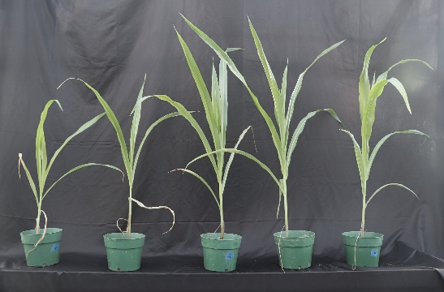
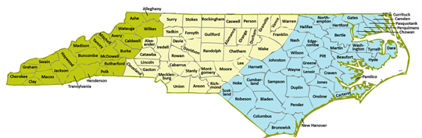
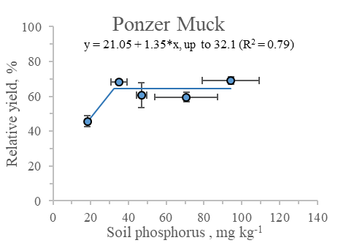
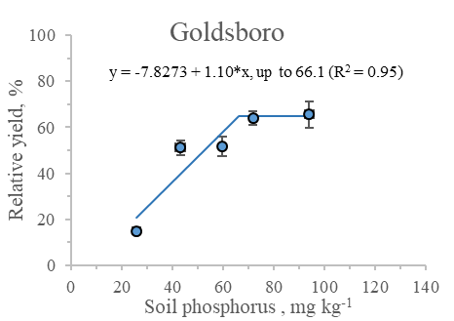
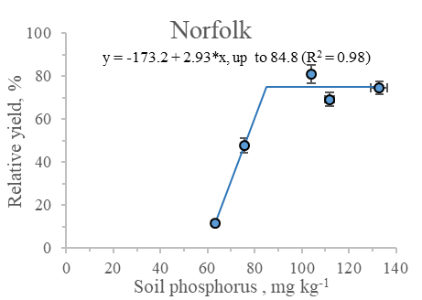
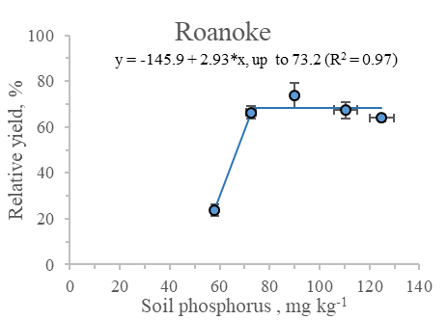
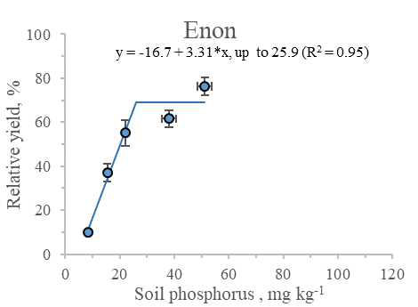
Soil test correlation in greenhouse
Anna Weigel
Objective: Are the CSTVs lower in Piedmont Soils?
Corn P CSTVs (DM up to 45 days at greenhouse)
Norfolk
85
Enon
26
Pantego
85
Lloyd
42
CLC
60
Goldsboro
66
Cecil
72
Roanoke
73
Ponzer
Muck
32
NGF
38

Slide 18

Critical Soil Test Values for NC soils and Crops
Shelton et al. (1961)
Cox & Lins (1984)
Cox (1992)
Cox (1996)
Kamprath (1999)
Cox & Barnes (2002)
Crozier et al. (2004)
67
64
Current CSTV
57
56
2020
2021
2022
14
14
Corn
n=15
Cotton
n=7
Peanut
n=6
Soy
n=6
Wheat
n=5
Wheat
n=3
Corn
n=3
Soy
n=1
Coastal Plain/Tidewater
Piedmont

Slide 19
Final thoughts
The P CSTVs (2020-2022) were higher than the historically observed for the Coastal Plain
The P CSTV at 60 mg/dm³ seems adequate for corn and soybean in the Coastal Plain
The P CSTV at 60 mg/dm³ is too high for P-buffered soils from the Piedmont
Greenhouse trials support the need of a lower CSTVs for P-buffered soils
It is not necessary to develop different fertilizer recommendations for high-yielding soybean
The results are inconclusive for potassium and further studies are necessary

Slide 20


Thank you!
Luke Gatiboni
Extension Soil Fertility Specialist
Luke_Gatiboni@ncsu.edu
919-613-0968
919-649-9196

